Slide 1


REGISTRAR SERVICES SYSTEM
Neil Orven Cueto
Jonathan Abalon
Aaron Dagatan
Carl Joshua Lavarro

Slide 2
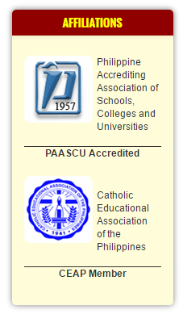
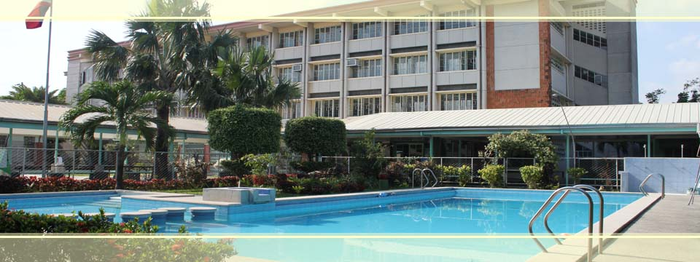


PROJECT CONTEXT

Slide 3



PURPOSE
To Identify
To Study
To focus

Slide 4
OBJECTIVE
Provide an integrated Registrar system
To ensure efficient management of student records
To develop automated grading system

Slide 5
SCOPE AND LIMITATION
Scope
Enrollment Procedures
Grade Submission
Limitation
Intranet-based system

Slide 6
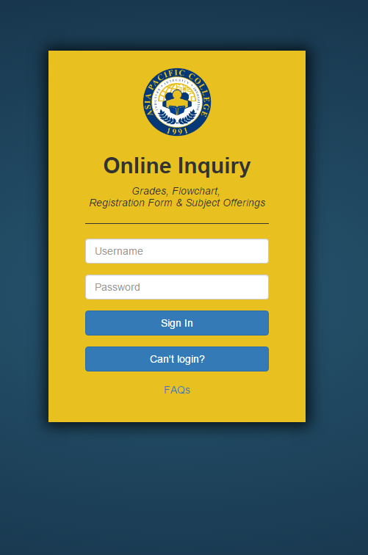
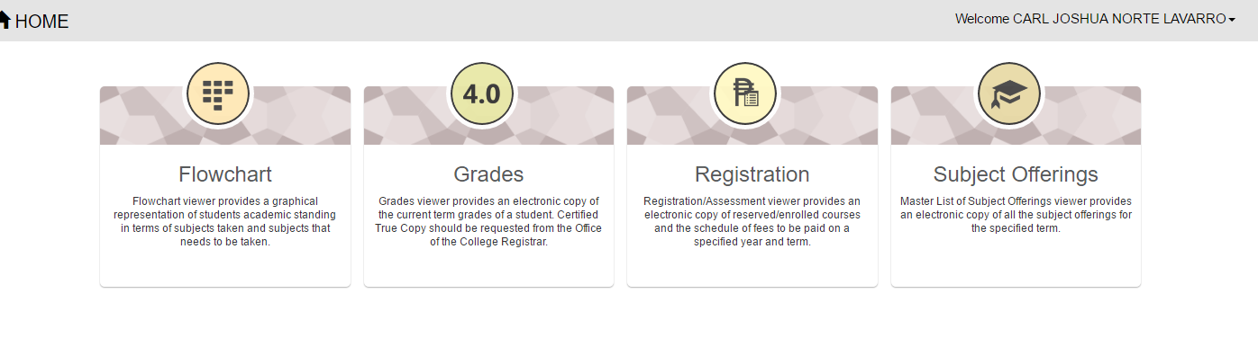
RELATED LITERATURE
APC FLAVIO

Slide 7
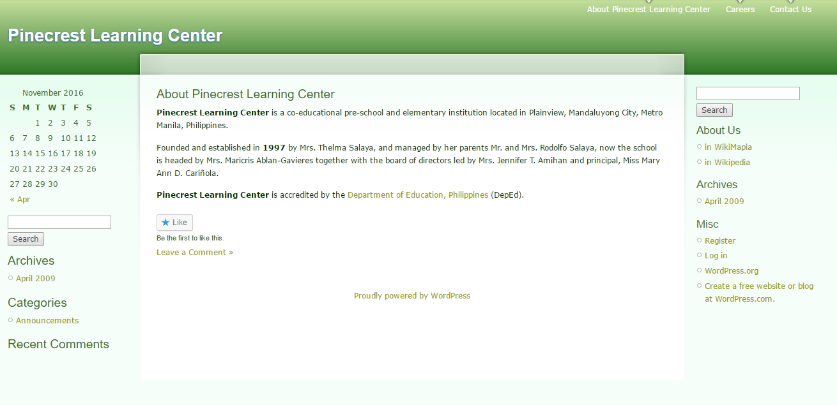
RELATED LITERATURE
PINECREST LEARNING CENTER

Slide 8
TECHNICAL BACKGROUND
Web-based Server System Requirements 1. Minimum Hardware Requirements -Processor: Dual Core CPU 2.0GHz -Instruction Set: 64-bit -RAM: 8GB -HDD: 1TB 2. Operating System -Windows 7 SP1 (32-bit/64-bit); OR -Microsoft Windows Server 2008 SP2 (32-bit); OR -Microsoft Windows Server 2012 (64-bit) 3. Database Requirements -XAMPP Control Panel 4. Server -Apache

Slide 9
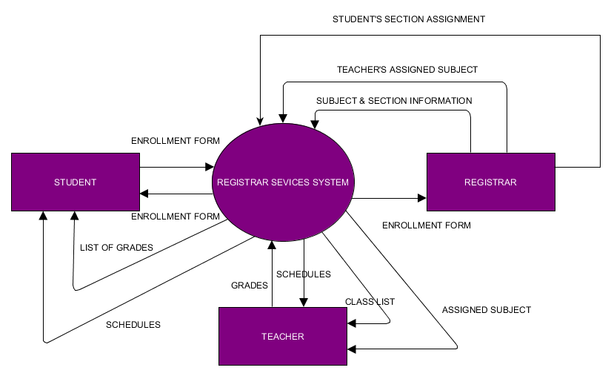
CONTEXT DIAGRAM

Slide 10
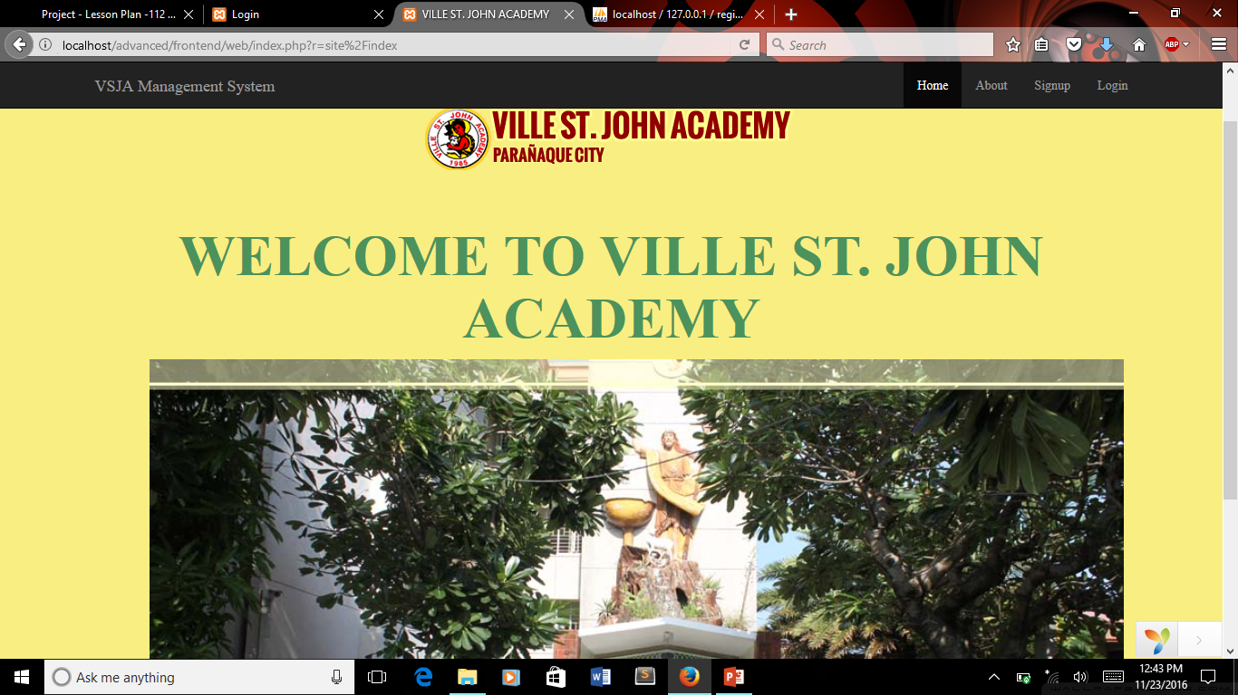
PROTOTYPE SYSTEM

Slide 11
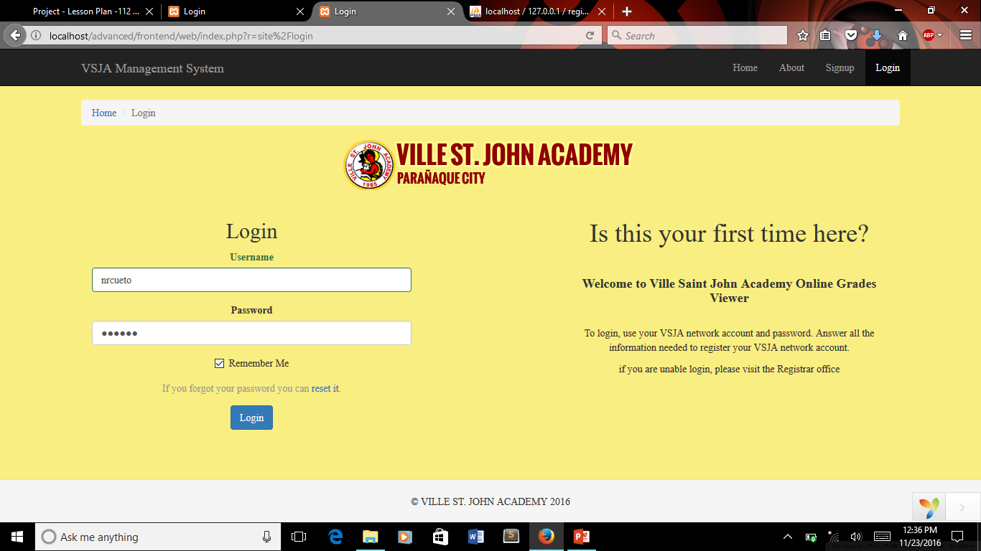
PROTOTYPE SYSTEM

Slide 12
End of Presentation

